Slide 1
WORLD OF DRONES
Drone Definition

Slide 2
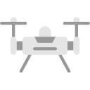
?
WHAT IS A DRONE?
Drones are more formally known as Unmanned Aerial Vehicles (UAV).
Essentially, a drone is a flying robot.

Slide 3
?
WHAT IS A DRONE?
The aircraft may be remotely controlled or can fly autonomously through software-controlled flight plans in their embedded systems working in conjunction with GPS.

Slide 4
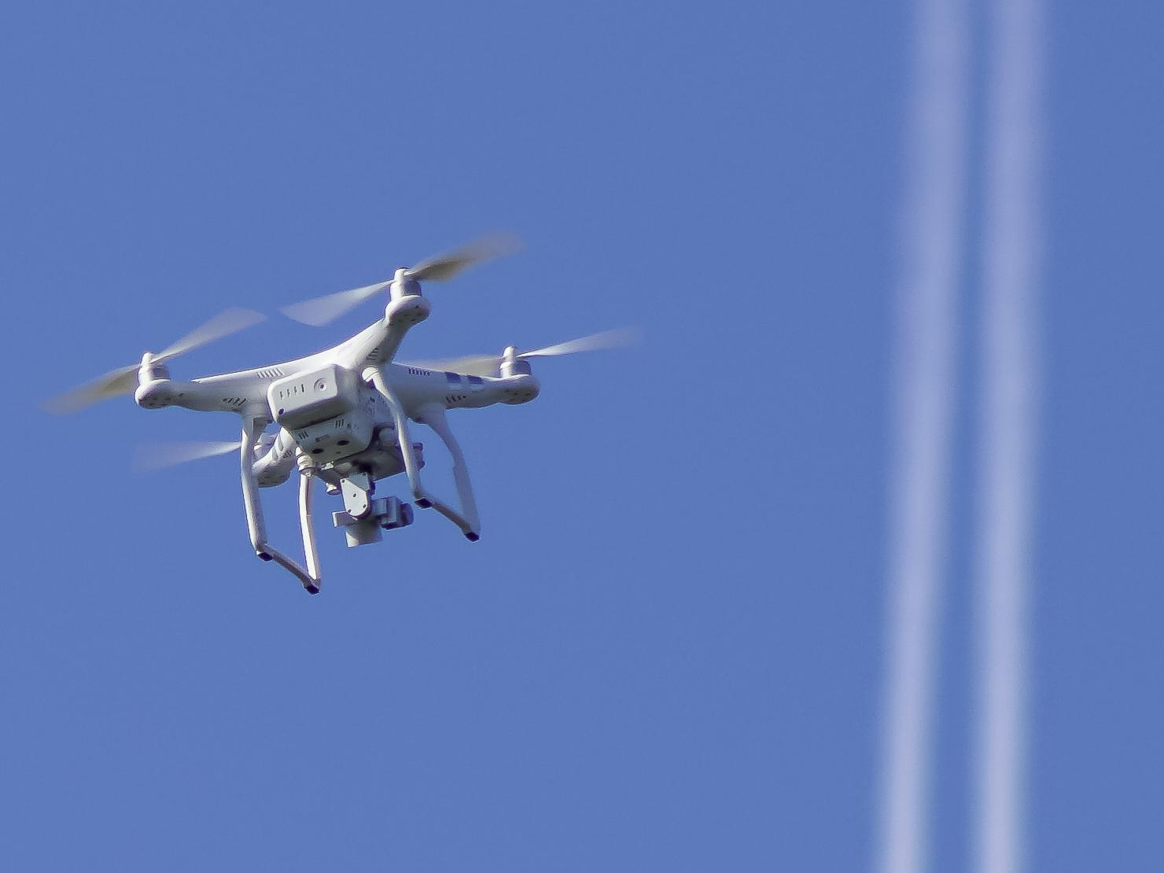
VS
Manned Aircraft UAV
Compared to manned aircraft, UAVs are often preferred for missions that are too dangerous for humans. They originated mostly in military applications, although their use is expanding in other areas.

Slide 5
?
WELL DONE!
Now you can move on to the next topic...
Design: Manned Aircraft vs UAV!

